Slide 1
Air Quality in Allegheny County
Which area/neighborhood has the worst air pollution?

Slide 2
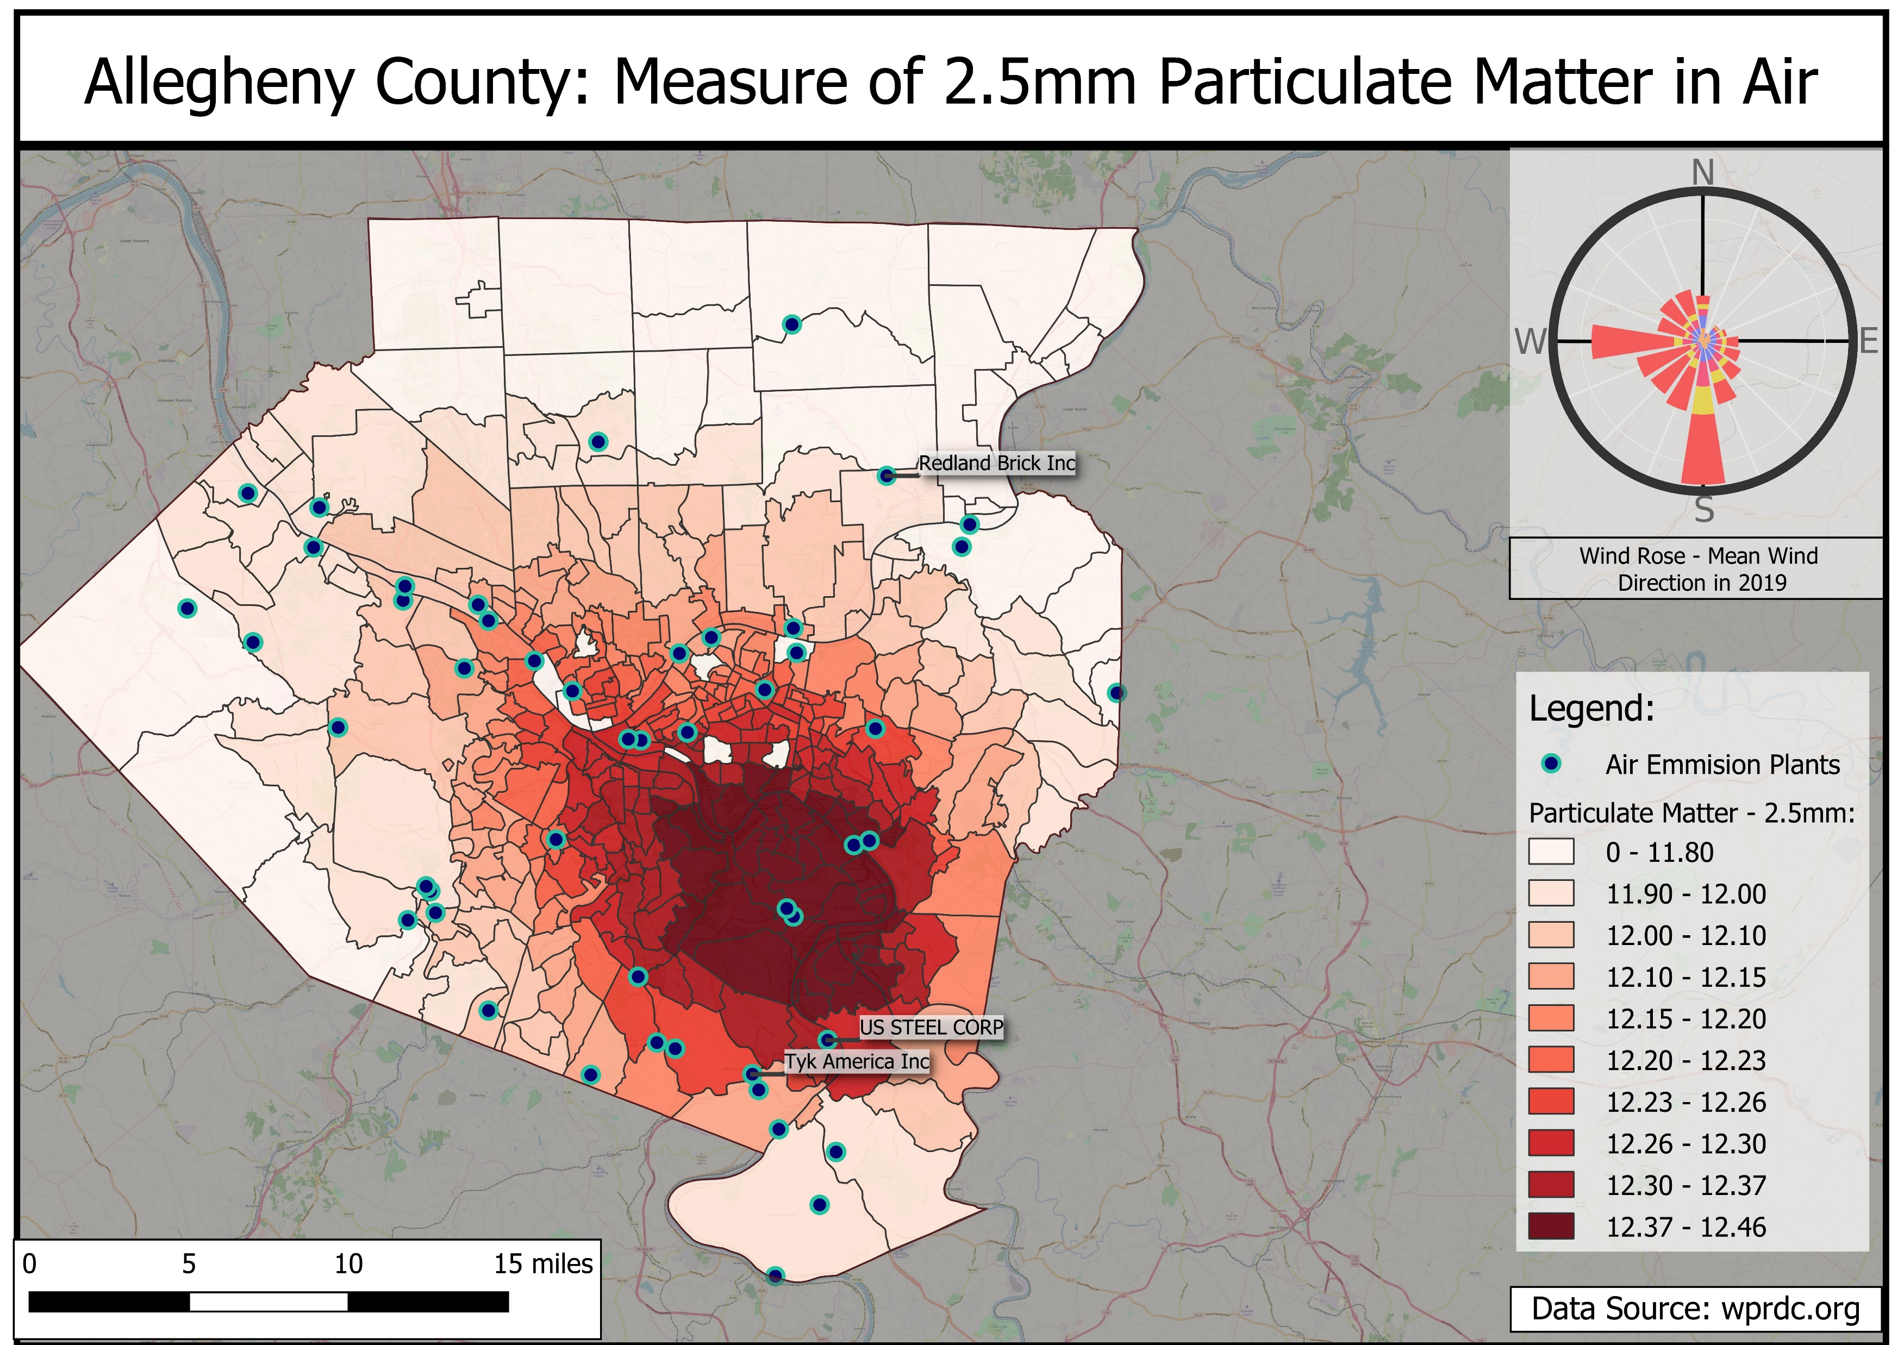

Slide 3
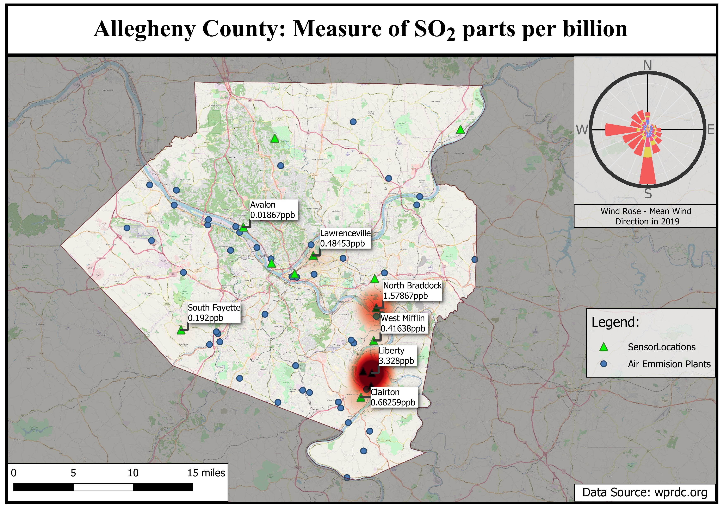

Slide 4
Sulfur Dioxide
Sources of SO₂
Burning fossil fuels – coal, oil, diesel.
Locations such as power plants, metals processing and smelting facilities, and automobiles.
Data was recorded hourly, then averaged to result in a daily value.
The SO₂ map shows the average daily value per year in parts per billion.

Slide 5
Sources
Allegheny County Air quality
https://data.wprdc.org/dataset/allegheny-county-air-quality
https://catalog.data.gov/dataset/allegheny-county-air-quality
Pollution Map
https://breatheproject.org/pollution-map/
EPA Search
https://edg.epa.gov/metadata/catalog/main/home.page
Allegheny County Particulate Matter - 2.5mm
https://data.wprdc.org/dataset/particulate-matter-2-5

Slide 6
Sources
Wind rose sites
https://www.meteoblue.com/en/weather/archive/windrose/pittsburgh_united-states-of-america_5206379
https://wrcc.dri.edu/cgi-bin/wea_windrose.pl?laKAGC
https://mrcc.illinois.edu/CLIMATE/Hourly/WindRose.jsp
https://www.climate.gov/maps-data/dataset/wind-roses-charts-and-tabular-data
Pittsburgh Data
http://www.pasda.psu.edu/
http://www.wprdc.org/

